Slide 1

PCWG-Share-01 Current Status
PCWG Meeting Hamburg
10th March 2016
Peter Stuart (RES) and Andy Clifton (NREL), on behalf of the Power Curve Working Group

Slide 2
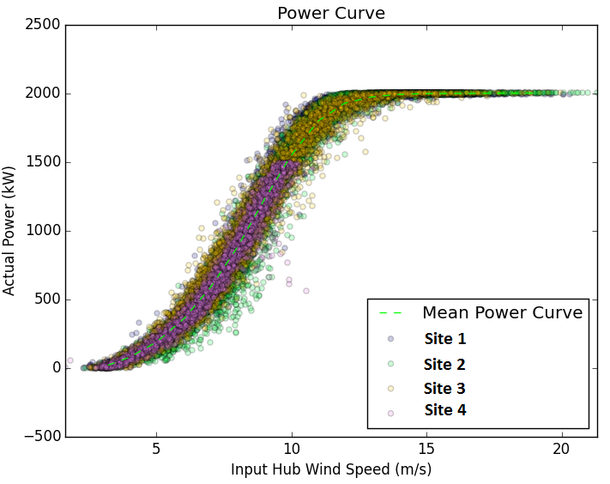
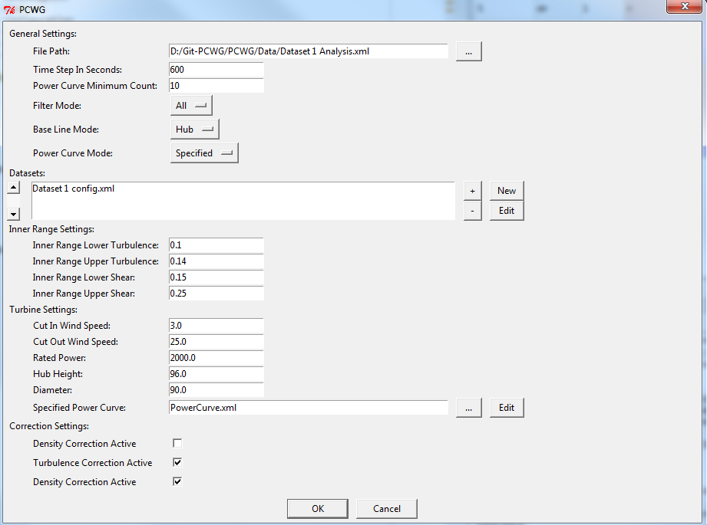
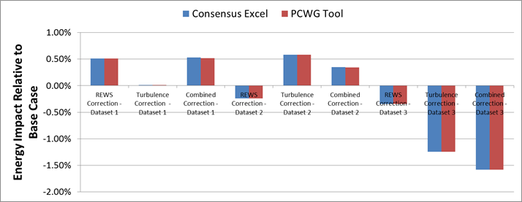
PCWG-Share-01: PCWG Analysis Tool
PCWG-Share-01: Enabled by PCWG Analysis Tool.
Consistent data analysis and anonymous report generation.
‘Just do it’ PCWG-Share-01 button (minimise set-up time)
Excel Benchmark and PCWG Analysis Tool Comparison

Slide 3
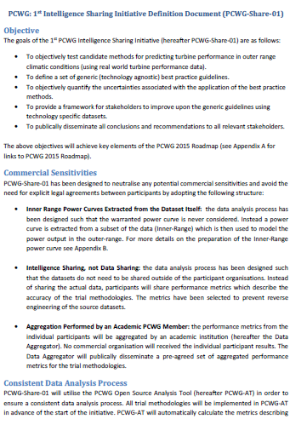
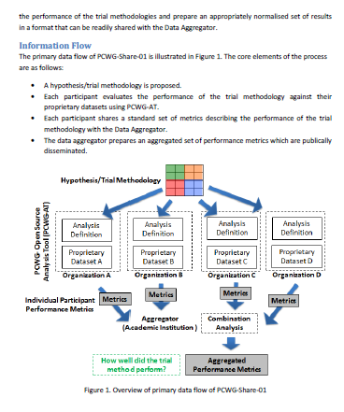
PCWG-Share-01 Definition Document
Download PCWG-Share-01 Definition Doc from www.pcwg.prg

Slide 4
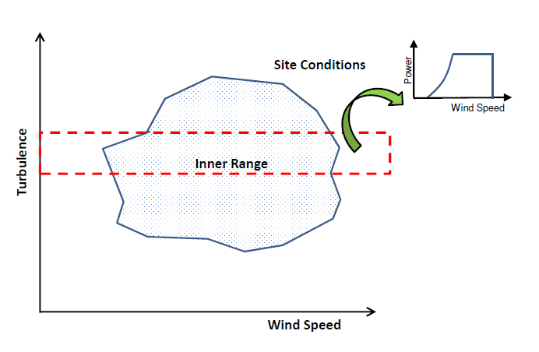
PCWG-Share-01: Neutralising Commercial Sensitivities
Inner Range Power Curves Extracted from the Dataset Itself: the data analysis process has been designed such that the warranted power curve is never considered. Instead a power curve is extracted from a subset of the data (Inner-Range) which is then used to model the power output in the outer-range.
Intelligence Sharing, not Data Sharing: the data analysis process has been designed such that the datasets do not need to be shared outside of the participant organisations. Instead of sharing the actual data, participants will share performance metrics which describe the accuracy of the trial methodologies.

Slide 5
PCWG-Share-01: Data Flow
Hypothesis/Trial Methodology
Analysis Definition Y
Analysis Definition Y
Analysis Definition Y
Analysis Definition Y
Proprietary Dataset A
Proprietary Dataset B
Proprietary Dataset C
Proprietary Dataset D
Organization A
Organization B
Organization C
Organization D
Hypothesis Performance Metrics
Aggregator
(Academic Institution )
Combination Analysis
How well did the trial method perform?
Aggregated Hypothesis Performance Metrics

Slide 6
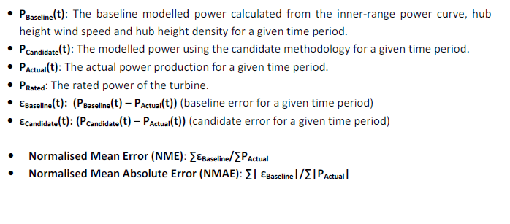
PCWG-Share-01: Error Metric Definitions
See PCWG-Share-01 Definition Document for Further Details

Slide 7
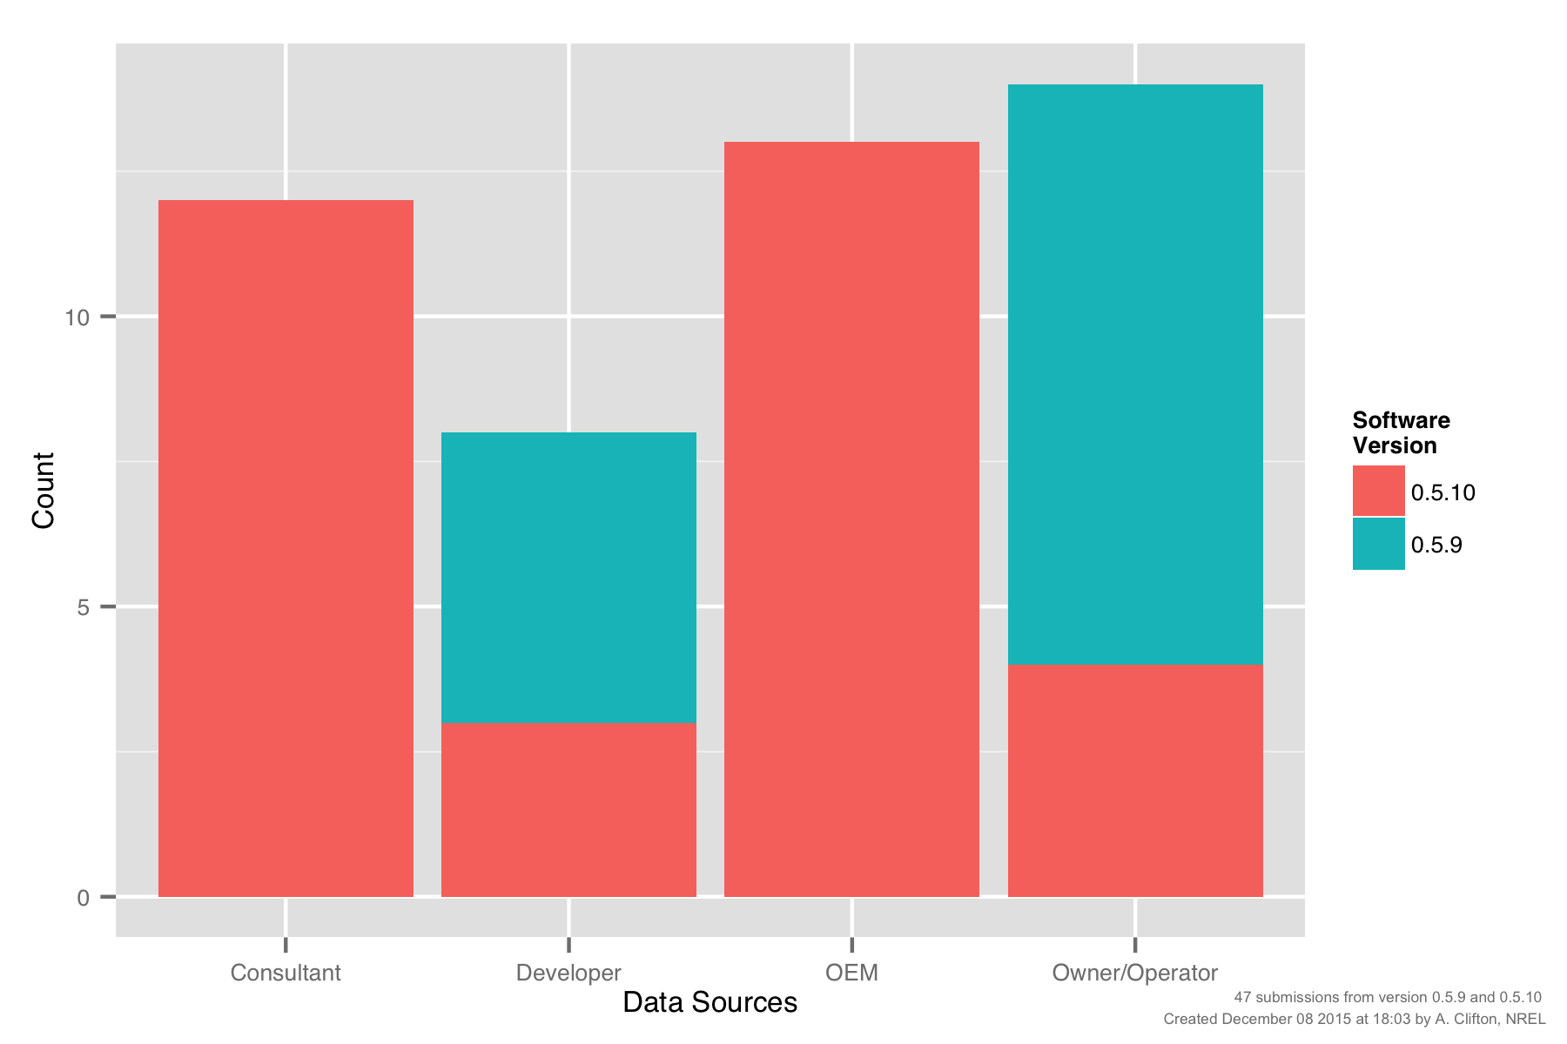
PCWG-Share-01: Submissions by Participant Type

Slide 8
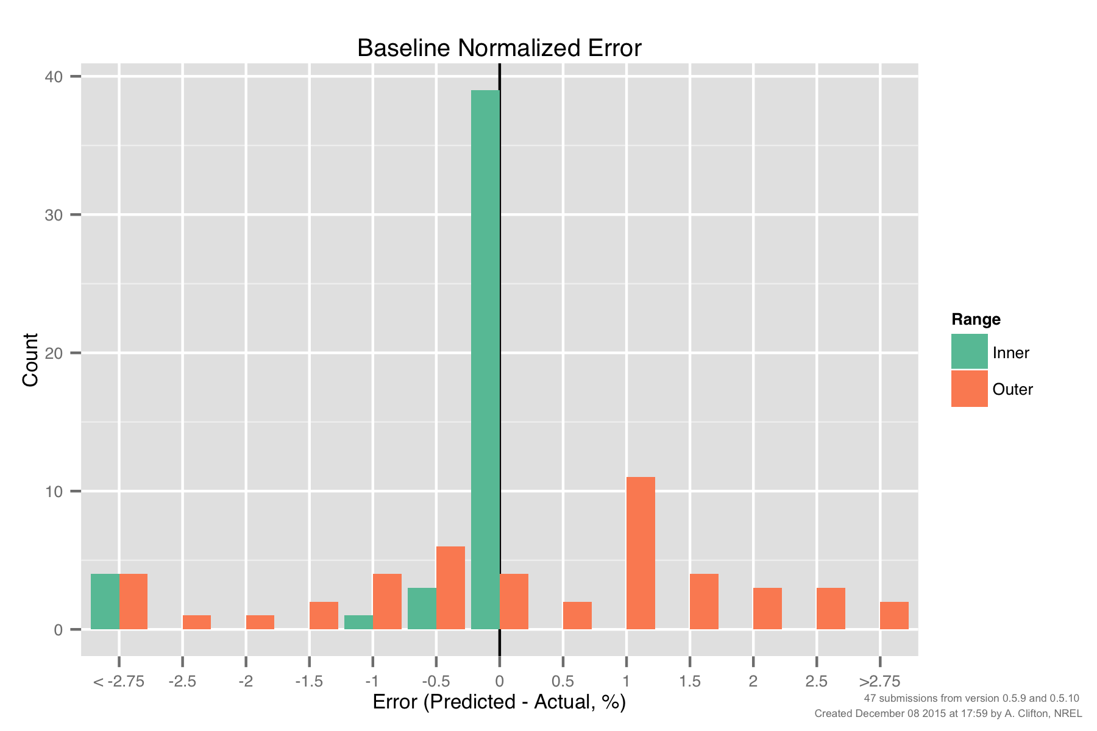
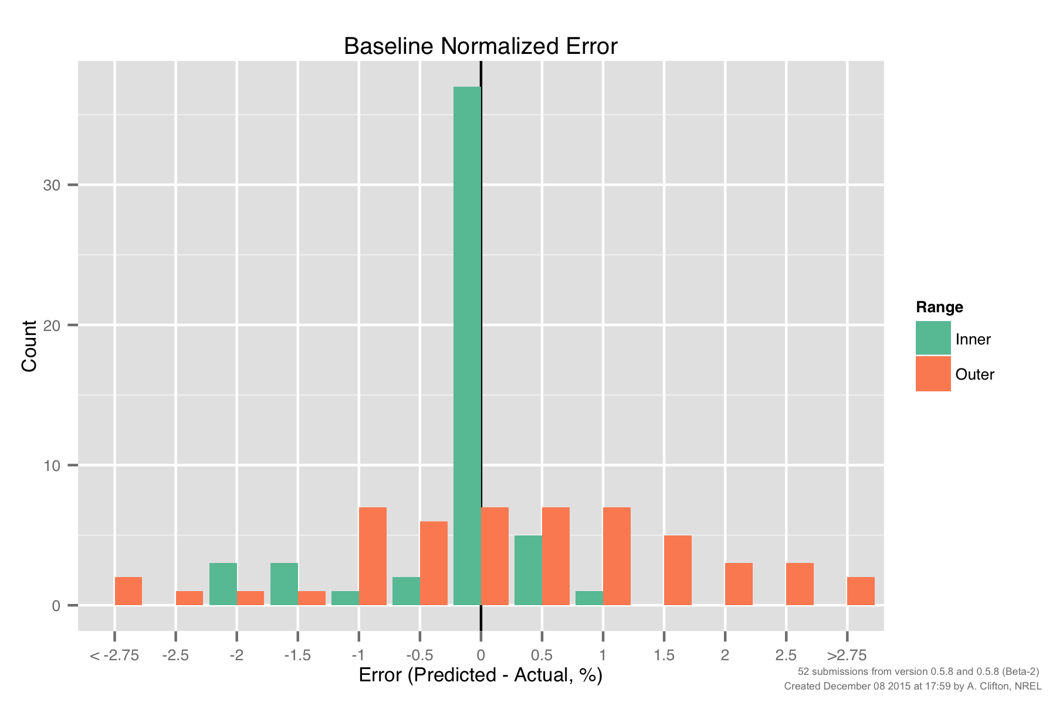
PCWG-Share-01: Baseline Error, Inner vs Outer Range
Version 0.5.9/10
Erroneous Outliers: unexpectedly large errors for baseline inner range
Interpolation Issue: Smaller inner baseline errors still warrant further investigation
‘Uncertainty’ associated with
‘Outer Range’ effects.
Std Dev ≈ 2%

Slide 9
POWER CURVE
INTERPOLATION ISSUE

Slide 10
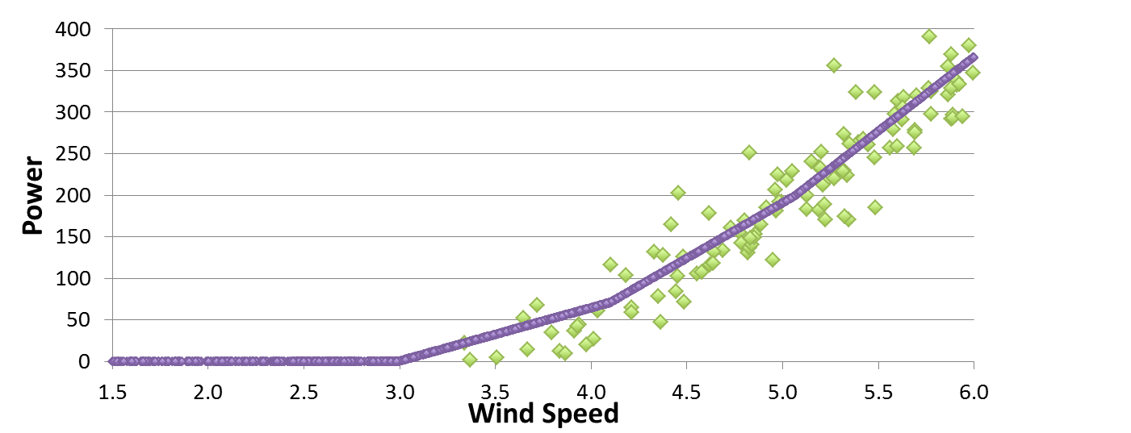
Inner Range Baseline Error
What is inner range baseline error?
The Inner Range power curve is derived from the Inner Range data
Each Inner Range data point is compared to the Inner Range power curve. The error for each data point is calculated.
The error is summarised as NME (Normalised Mean Error). This is expected to be 0 for the inner range!
HOWEVER The inner range baseline error may not be 0 depending on interpolation of the power curve!
Error for each point is the difference from the interpolated power curve

Slide 11
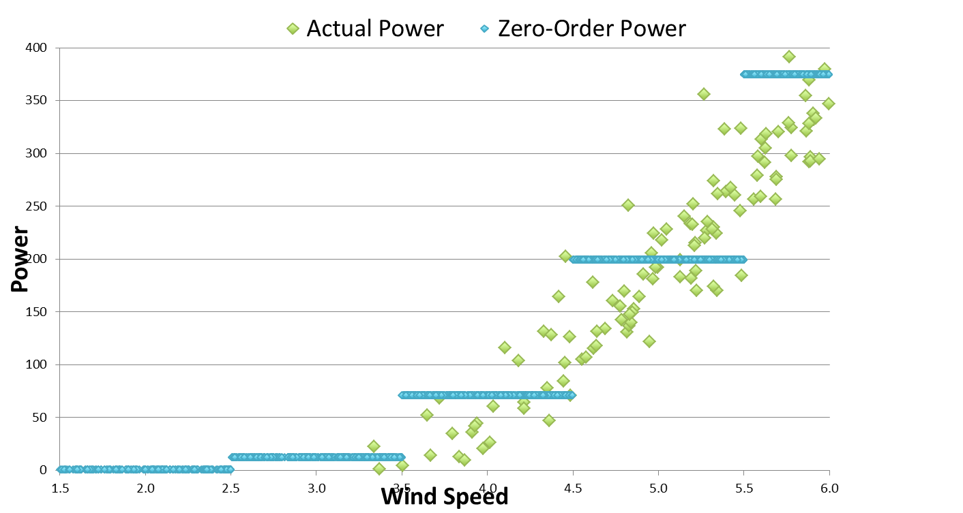
Zero-Order interpolation: easy to get 0 NME (just use the bin average power) but large errors for individual data points.

Slide 12
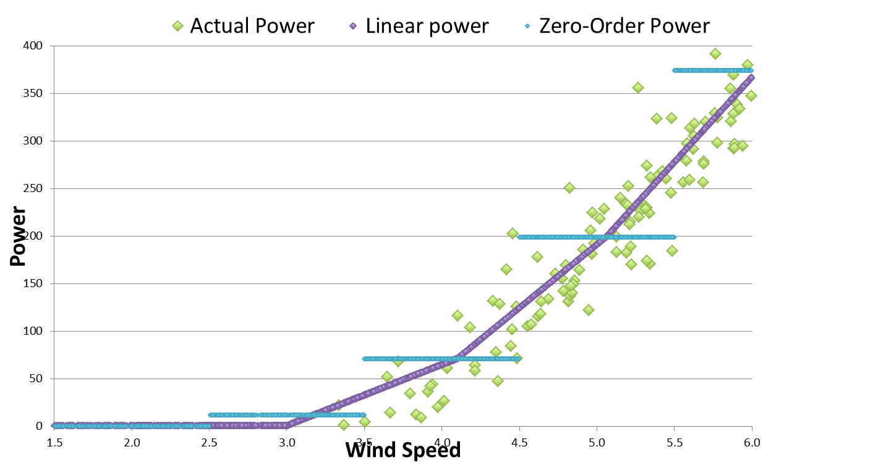
Linear Interpolation: v0.5.8 and earlier, improvement for individual data points but noticeable over prediction at low wind speed

Slide 13
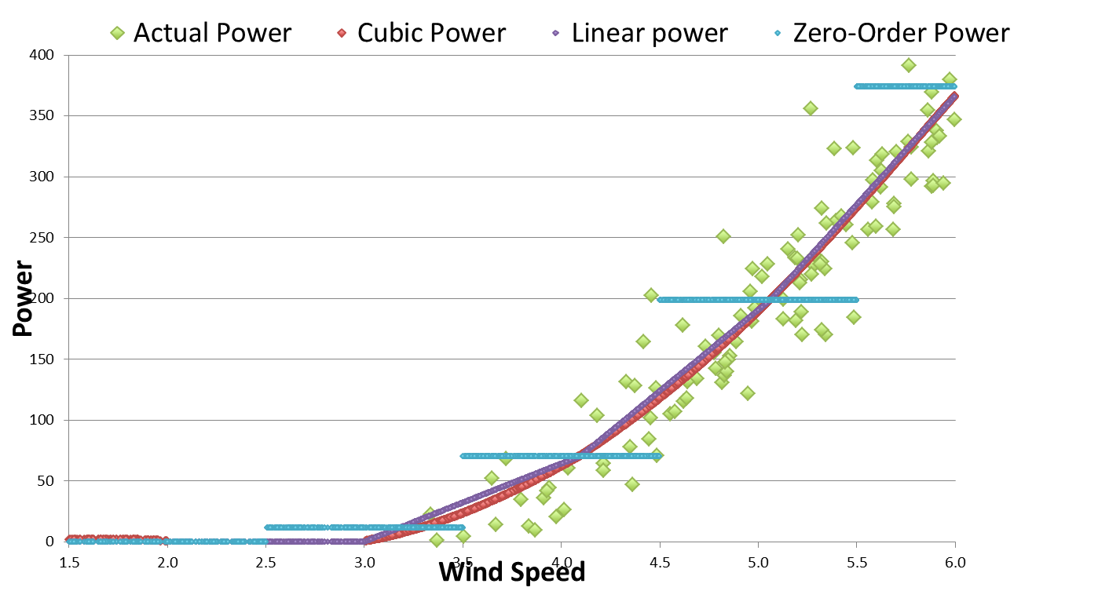
Cubic interpolation: introduced in v0.5.9 for PCWG-Share-01. Noticeably reduces error at low wind speed compared to linear.

Slide 14
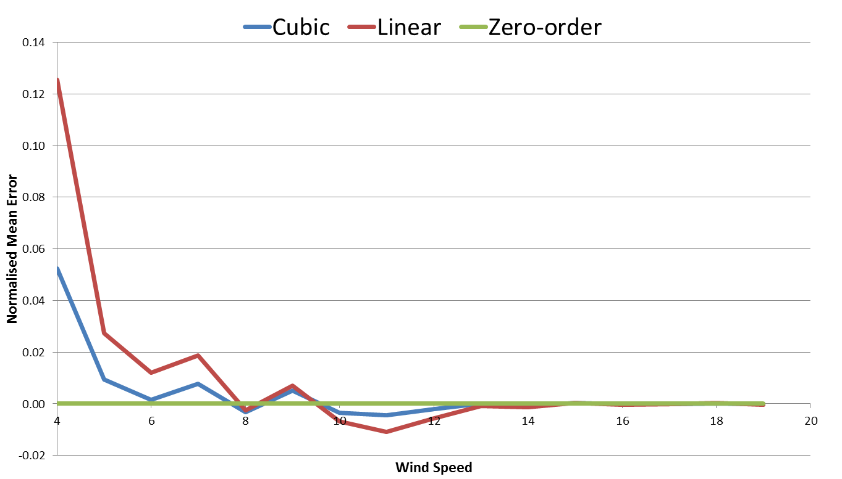
Normalised Mean Error (NME) by wind speed:
Cubic interpolation has similar but smaller errors than linear.
Zero-order has 0 error by definition
Cubic and linear interpolators over estimate data at the ankle
Cubic and linear interpolators under estimate data at the knee

Slide 15
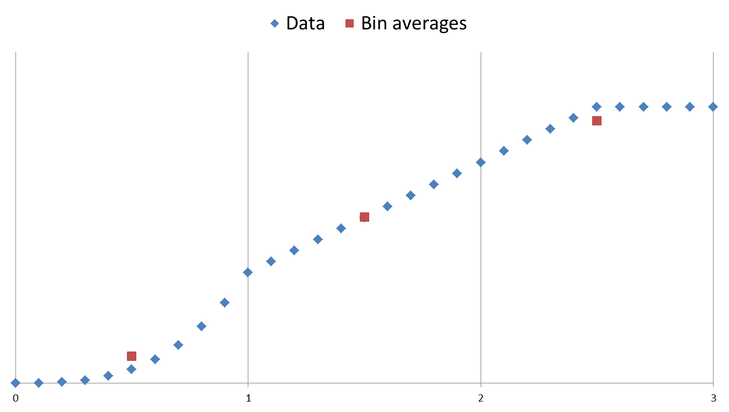
Residual Error
Main reason for residual error: Bin averages are used as interpolation points. Unfortunately the bin averages do not lie exactly on the curve when the underlying function is non-linear.
Cubic
(Convex)
Clipped
(Concave)
Linear
The bin average, (avg(x), avg(y)),
is below the curve
The bin average, (avg(x), avg(y)),
is above the curve
The bin average, (avg(x), avg(y)),
is on the curve

Slide 16
Possible solutions
The problem is that bin average power does not well represent bin centre power
The bin averaging process is very similar to the effect of turbulence. An iterative correction method similar to the Albers method could be applied to find the true bin centres.
In the rising part of the curve, evaluate bin average Cp, consider this to be bin centre Cp, and convert to bin centre power. Cp data is a bit less non-linear than power.

Slide 17
Erroneous Outlier Issue

Slide 18
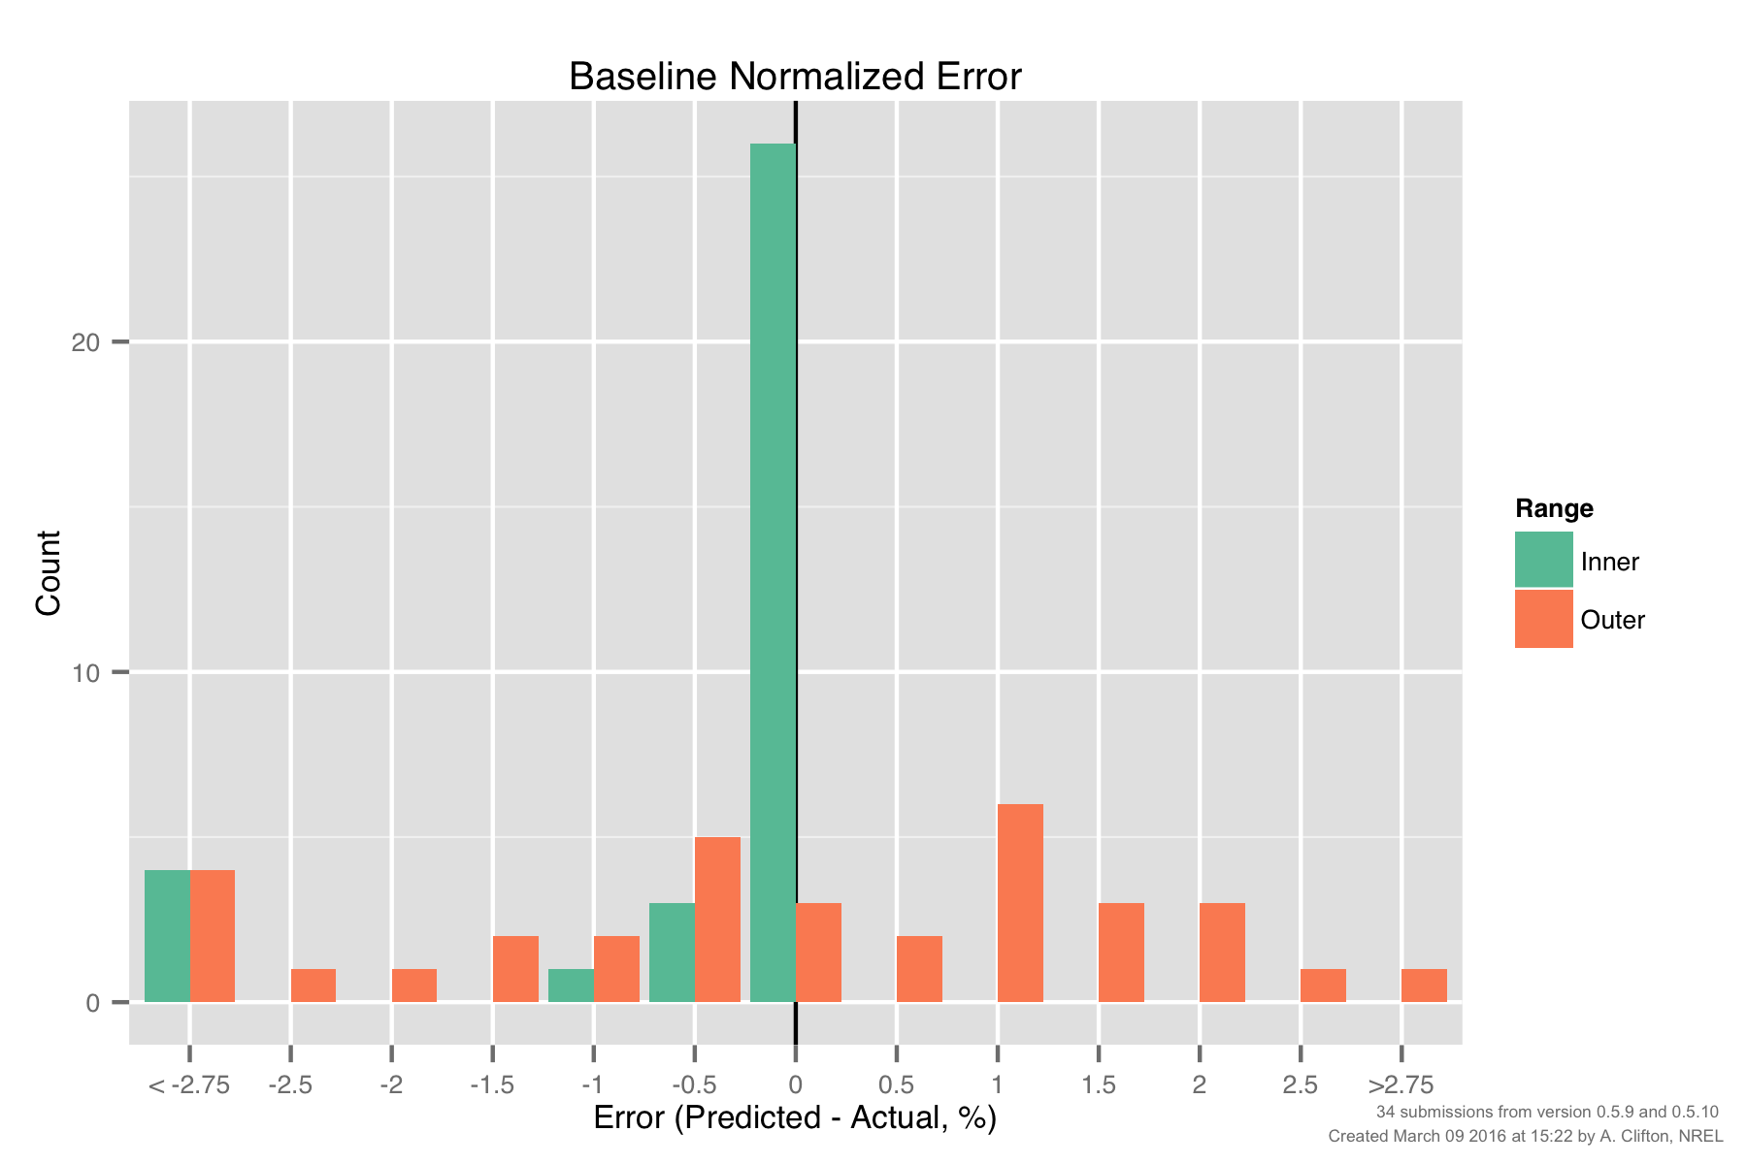
PCWG-Share-01: Baseline Histogram for ‘Follow Up’ Datasets
PCWG participants were asked for permissions to allow the data aggregator to investigate their submissions for sources of error.
Owners of 34 datasets responded positivity. A baseline NME histogram for these participants is shown below.

Slide 19
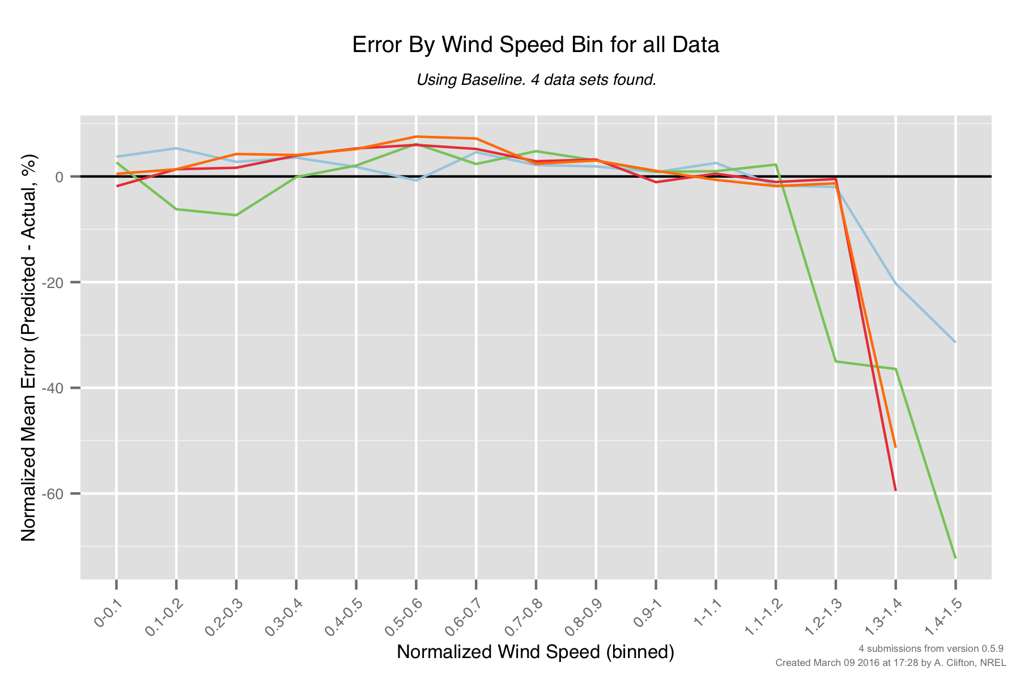
PCWG-Share-01: Baseline Errors by Wind Speed (Outliers Only)
The 4 large negative NME outliers all have a distinct ‘by wind speed error signature’.
Further investigation is required to ascertain what is going on with these datasets.
Large errors at high wind speeds

Slide 20
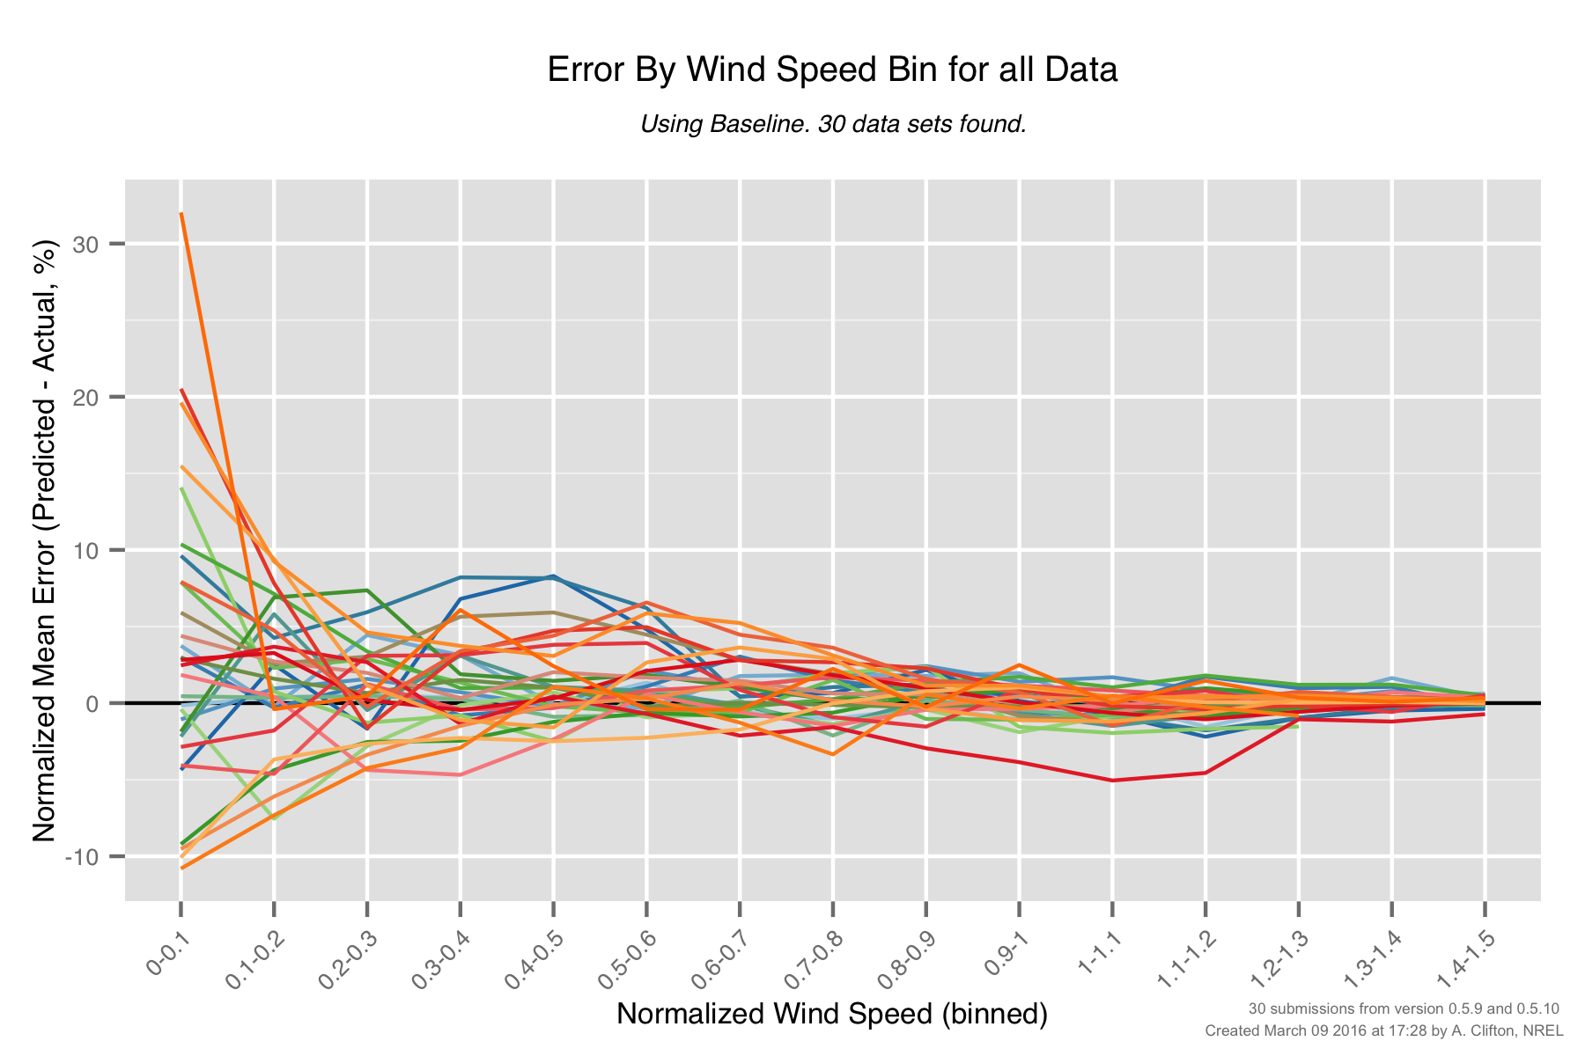
PCWG-Share-01: Baseline Errors by Wind Speed (Non-outliers)
The ‘by wind speed’ errors of the non-outliers look more reasonable, although some notable behaviour is observed (as highlighted).
Re-plot once interpolation issue is resolved.
Interpolation Issue
Notable behaviour for ‘blue’ dataset.
Notable behaviour for ‘red’ dataset.

Slide 21
PCWG-Share-01 RESULTS
Selected Results Only: For Full results see December 2015Meeting Proceedings

Slide 22
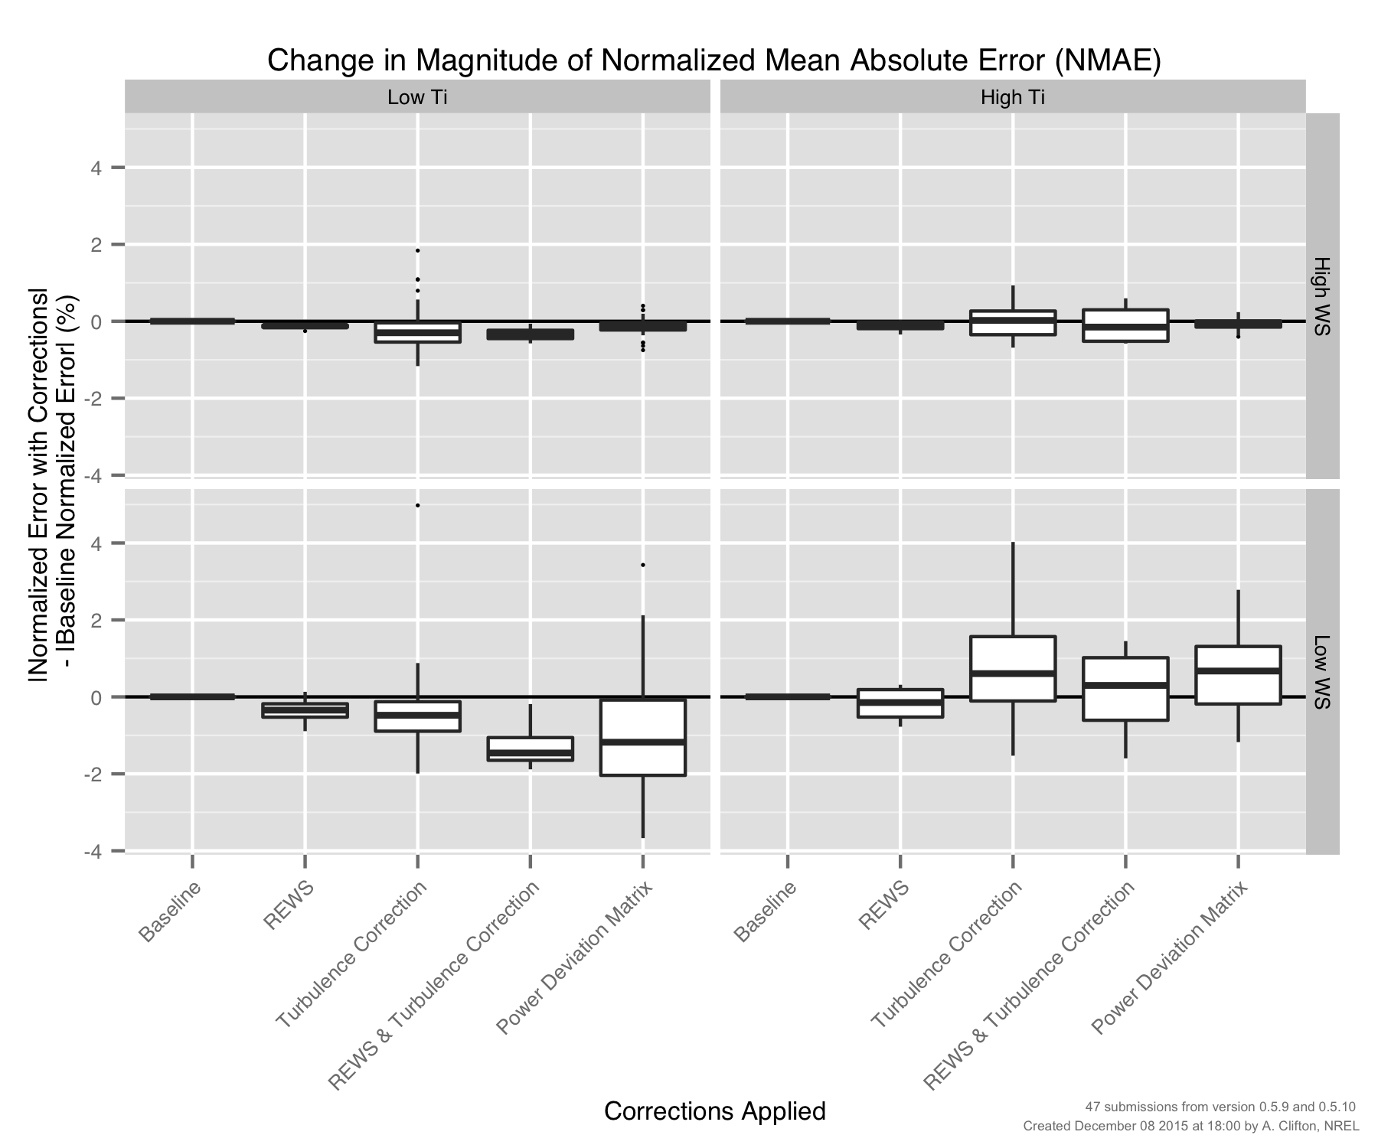
PCWG-Share-01: Errors by Method (‘Four Cell Matrix’)
Need to eliminate baseline issues to get a clear signal of which methods work best in which conditions.

Slide 23
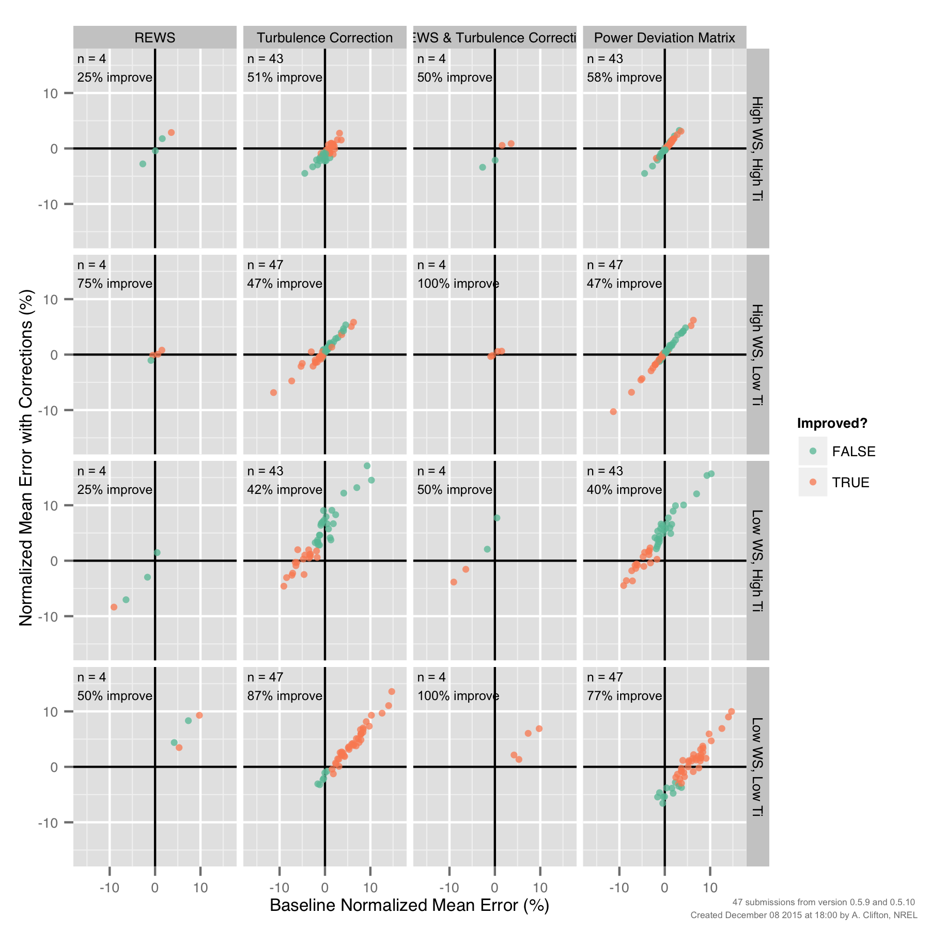
PCWG-Share-01: Improvements by Method (‘Four Cell Matrix’)
Need to eliminate baseline issues to get a clear signal of which methods work best in which conditions.

Slide 24
Many thanks to all PCWG-Share-01 Participants and special thanks to
Andy Clifton of NREL
Join the Power Curve Working Group at: www.pcwg.org

